Slide 1
Data Modeling Using the Entity-Relationship (ER) Model

Slide 2
Modeling
A database can be modeled as:
  a collection of entities,
  relationship among entities.
An entity is an object that exists and is distinguishable from other objects.
  Example: specific person, company, event, plant
Entities have attributes
  Example: people have names and addresses
An entity set is a set of entities of the same type that share the same properties.
  Example: set of all persons, companies, trees, holidays

Slide 3
ER Model Concepts
Entities and Attributes
  Entities are specific objects or things in the mini-world that are represented in the database. For example the EMPLOYEE John Smith, the Research DEPARTMENT, the ProductX PROJECT
  Attributes are properties used to describe an entity. For example an EMPLOYEE entity may have a Name, SSN, Address, Sex, BirthDate
  A specific entity will have a value for each of its attributes. For example a specific employee entity may have Name='John Smith', SSN='123456789', Address ='731, Fondren, Houston, TX', Sex='M', BirthDate='09-JAN-55‘
  Each attribute has a value set (or data type) associated with it – e.g. integer, string, subrange, enumerated type, …

Slide 4
Types of Attributes (1)
Simple
  Each entity has a single atomic value for the attribute. For example, SSN or Sex.
Composite
  The attribute may be composed of several components. For example, Address (Apt#, House#, Street, City, State, ZipCode, Country) or Name (FirstName, MiddleName, LastName). Composition may form a hierarchy where some components are themselves composite.
Multi-valued
  An entity may have multiple values for that attribute. For example, Color of a CAR or PreviousDegrees of a STUDENT. Denoted as {Color} or {PreviousDegrees}.

Slide 5
Types of Attributes (2)
In general, composite and multi-valued attributes may be nested arbitrarily to any number of levels although this is rare. For example, PreviousDegrees of a STUDENT is a composite multi-valued attribute denoted by {PreviousDegrees (College, Year, Degree, Field)}.

Slide 6
Entity Types and Key Attributes
Entities with the same basic attributes are grouped or typed into an entity type. For example, the EMPLOYEE entity type or the PROJECT entity type.
An attribute of an entity type for which each entity must have a unique value is called a key attribute of the entity type. For example, SSN of EMPLOYEE.
A key attribute may be composite. For example, VehicleTagNumber is a key of the CAR entity type with components (Number, State).
An entity type may have more than one key. For example, the CAR entity type may have two keys:
  VehicleIdentificationNumber (popularly called VIN) and
  VehicleTagNumber (Number, State), also known as license_plate number.

Slide 7
ENTITY SET corresponding to the ENTITY TYPE CAR
CAR
Registration(RegistrationNumber, State), VehicleID, Make, Model, Year, (Color)
car₁
((ABC 123, TEXAS), TK629, Ford Mustang, convertible, 1999, (red, black))
car₂
((ABC 123, NEW YORK), WP9872, Nissan 300ZX, 2-door, 2002, (blue))
car₃
((VSY 720, TEXAS), TD729, Buick LeSabre, 4-door, 2003, (white, blue))
.
.
.

Slide 8
Relationships and Relationship Types
A relationship relates two or more distinct entities with a specific meaning.
  For example, EMPLOYEE John Smith works on the ProductX PROJECT or EMPLOYEE Franklin Wong manages the Research DEPARTMENT.
Relationships of the same type are grouped or typed into a relationship type.
  For example, the WORKS_ON relationship type in which EMPLOYEEs and PROJECTs participate, or the MANAGES relationship type in which EMPLOYEEs and DEPARTMENTs participate.
The degree of a relationship type is the number of participating entity types.
  Both MANAGES and WORKS_ON are binary relationships.

Slide 9
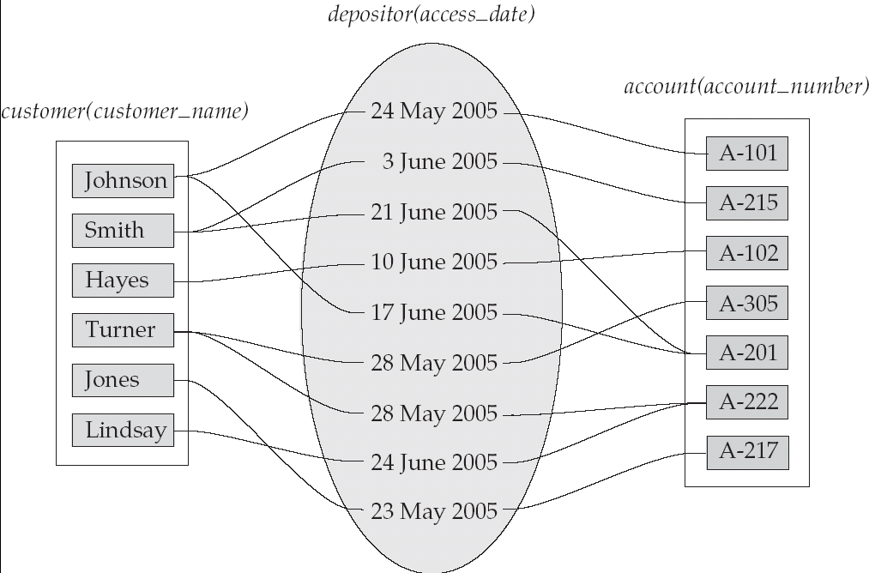
Relationship Sets
An attribute can also be property of a relationship set.
For instance, the depositor relationship set between entity sets customer and account may have the attribute access-date

Slide 10
Degree of a Relationship Set
Refers to number of entity sets that participate in a relationship set.
Relationship sets that involve two entity sets are binary (or degree two). Generally, most relationship sets in a database system are binary.
Relationship sets may involve more than two entity sets.
Relationships between more than two entity sets are rare. Most relationships are binary.
  Example: Suppose employees of a bank may have jobs (responsibilities) at multiple branches, with different jobs at different branches. Then there is a ternary relationship set between entity sets employee, job, and branch

Slide 11
Attributes
An entity is represented by a set of attributes, that is descriptive properties possessed by all members of an entity set. Example:
customer = (customer_id, customer_name, customer_street, city )
Domain – the set of permitted values for each attribute
Attribute types:
  Simple and composite attributes.
  Single-valued and multi-valued attributes
    Example: multivalued attribute: phone_numbers
  Derived attributes
    Can be computed from other attributes
    Example: age, given date_of_birth

Slide 12
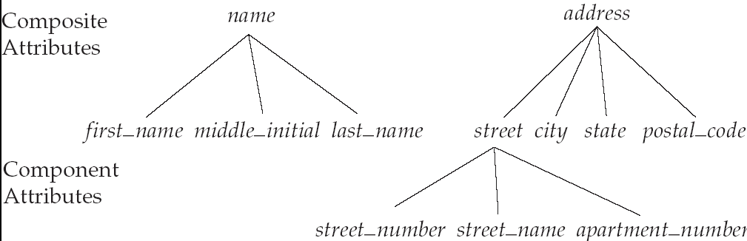
Composite Attributes

Slide 13
Mapping Cardinality Constraints
Express the number of entities to which another entity can be associated via a relationship set.
Most useful in describing binary relationship sets.
For a binary relationship set the mapping cardinality must be one of the following types:
  One to one
  One to many
  Many to one
  Many to many

Slide 14
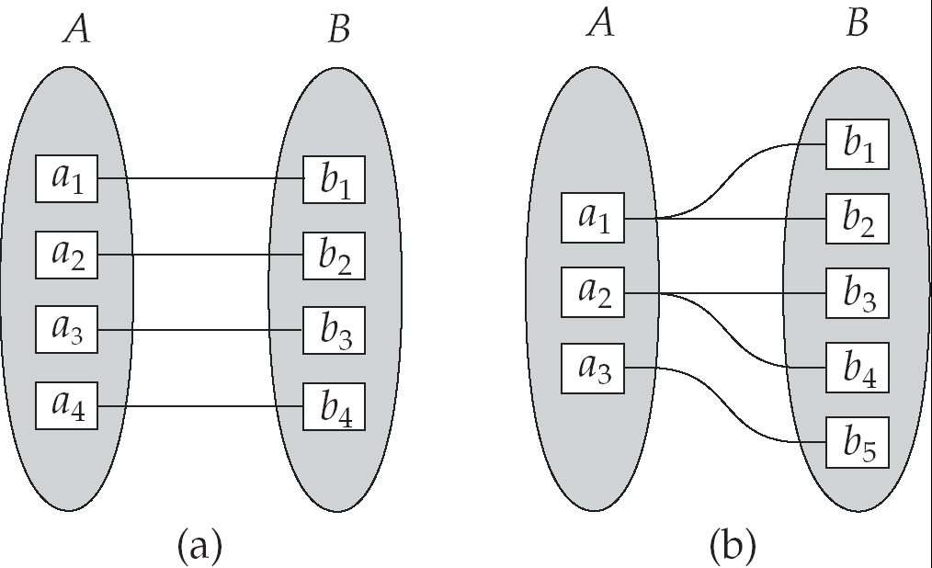
Mapping Cardinalities
One to one
One to many
Note: Some elements in A and B may not be mapped to any
elements in the other set

Slide 15
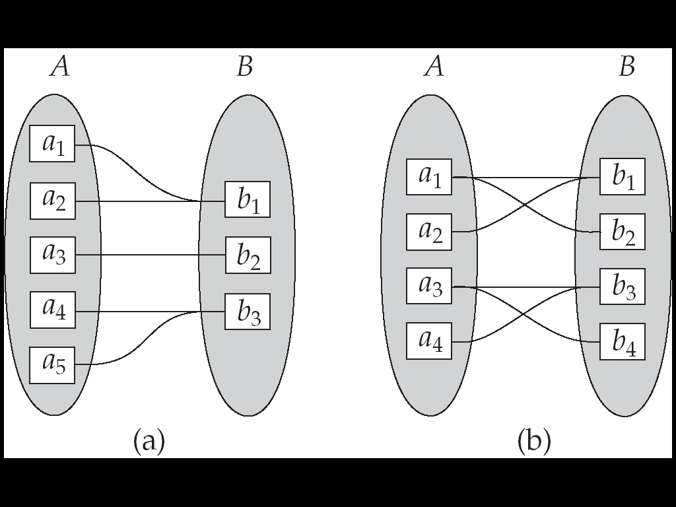
Mapping Cardinalities
Many to one
Many to many
Note: Some elements in A and B may not be mapped to any
elements in the other set

Slide 16
Keys
A super key of an entity set is a set of one or more attributes whose values uniquely determine each entity.
A candidate key of an entity set is a minimal super key
  Customer_id is candidate key of customer
  account_number is candidate key of account
Although several candidate keys may exist, one of the candidate keys is selected to be the primary key.

Slide 17
Keys for Relationship Sets
The combination of primary keys of the participating entity sets forms a super key of a relationship set.
  (customer_id, account_number) is the super key of depositor
Must consider the mapping cardinality of the relationship set when deciding what are the candidate keys
Need to consider semantics of relationship set in selecting the primary key in case of more than one candidate key

Slide 18
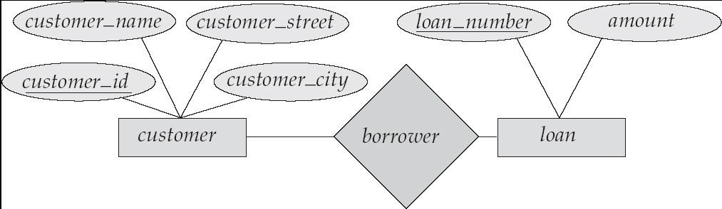
E-R Diagrams
Rectangles represent entity sets.
Diamonds represent relationship sets.
Lines link attributes to entity sets and entity sets to relationship sets.
Ellipses represent attributes
  Double ellipses represent multivalued attributes.
  Dashed ellipses denote derived attributes.
Underline indicates primary key attributes (will study later)

Slide 19
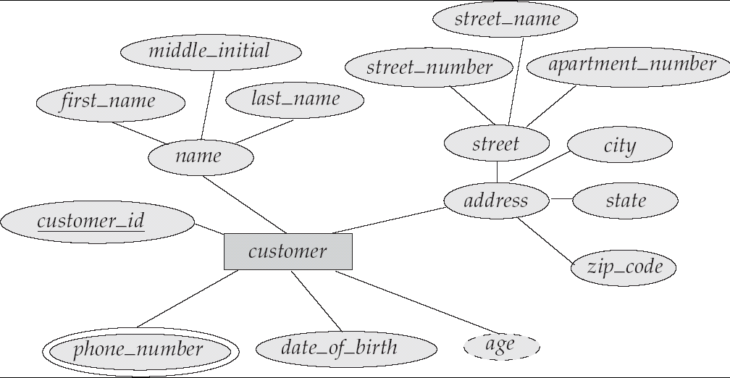
E-R Diagram With Composite, Multivalued, and Derived Attributes

Slide 20
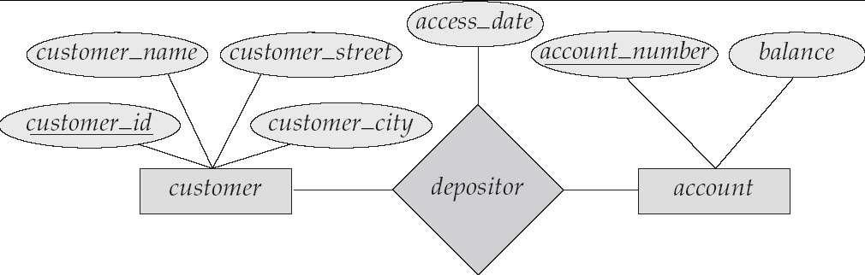
Relationship Sets with Attributes

Slide 21
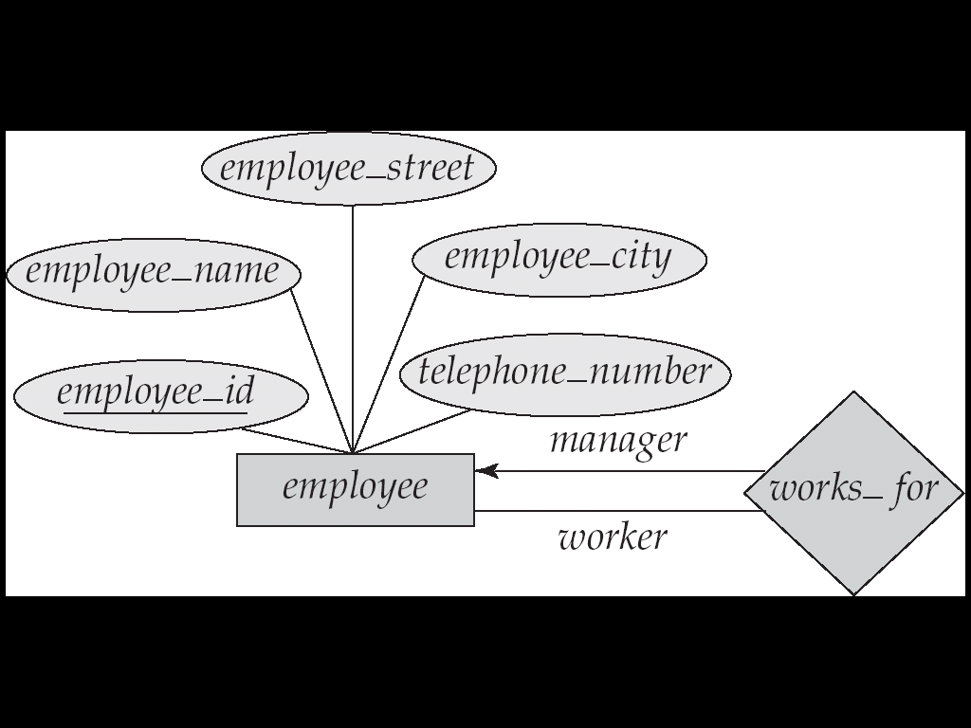
Roles
Entity sets of a relationship need not be distinct
The labels “manager” and “worker” are called roles; they specify how employee entities interact via the works_for relationship set.

Slide 22
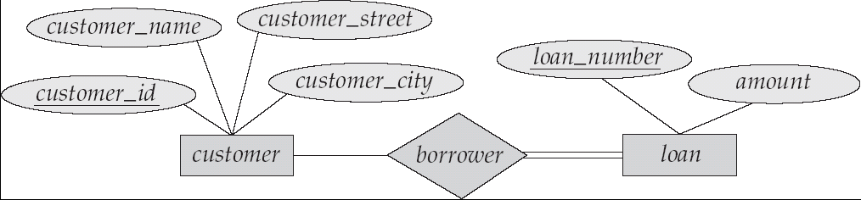
Participation of an Entity Set in a Relationship Set
Total participation (indicated by double line): every entity in the entity set participates in at least one relationship in the relationship set
  E.g. participation of loan in borrower is total
    every loan must have a customer associated to it via borrower
Partial participation: some entities may not participate in any relationship in the relationship set
  Example: participation of customer in borrower is partial

Slide 23
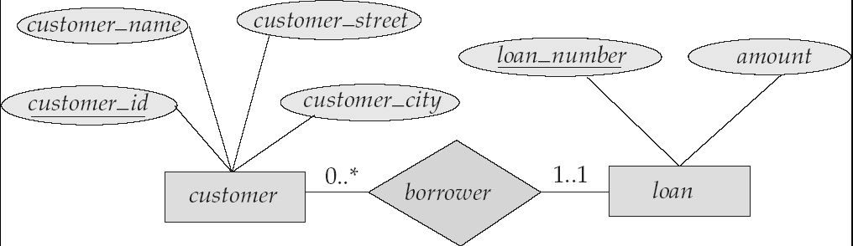
Alternative Notation for Cardinality Limits
Cardinality limits can also express participation constraints

Slide 24
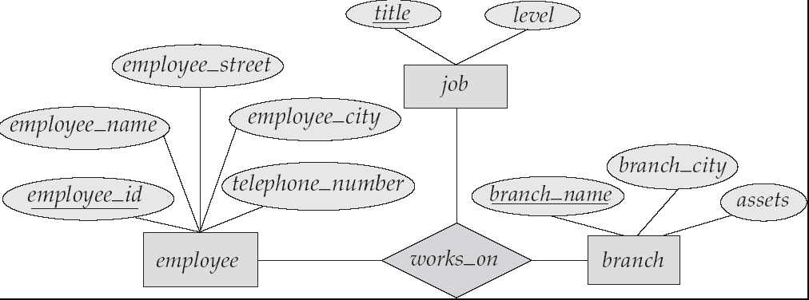
E-R Diagram with a Ternary Relationship

Slide 25
Weak Entity Sets
An entity set that does not have a primary key is referred to as a weak entity set.
The existence of a weak entity set depends on the existence of a identifying entity set
  it must relate to the identifying entity set via a total, one-to-many relationship set from the identifying to the weak entity set
  Identifying relationship depicted using a double diamond
The primary key of a weak entity set is formed by the primary key of the strong entity set on which the weak entity set is existence dependent, plus the weak entity set’s discriminator.

Slide 26
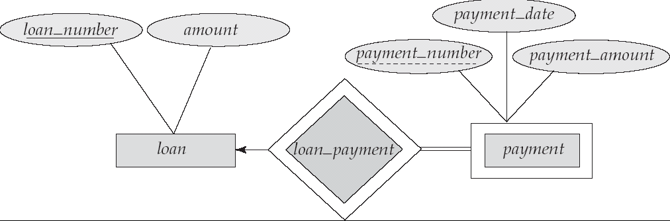
Weak Entity Sets
We depict a weak entity set by double rectangles.
We underline the discriminator of a weak entity set with a dashed line.
payment_number – discriminator of the payment entity set
Primary key for payment – (loan_number, payment_number)

Slide 27
Extended E-R Features: Specialization
Top-down design process; we designate subgroupings within an entity set that are distinctive from other entities in the set.
These subgroupings become lower-level entity sets that have attributes or participate in relationships that do not apply to the higher-level entity set.
Depicted by a triangle component labeled ISA (E.g. customer “is a” person).
Attribute inheritance – a lower-level entity set inherits all the attributes and relationship participation of the higher-level entity set to which it is linked.

Slide 28
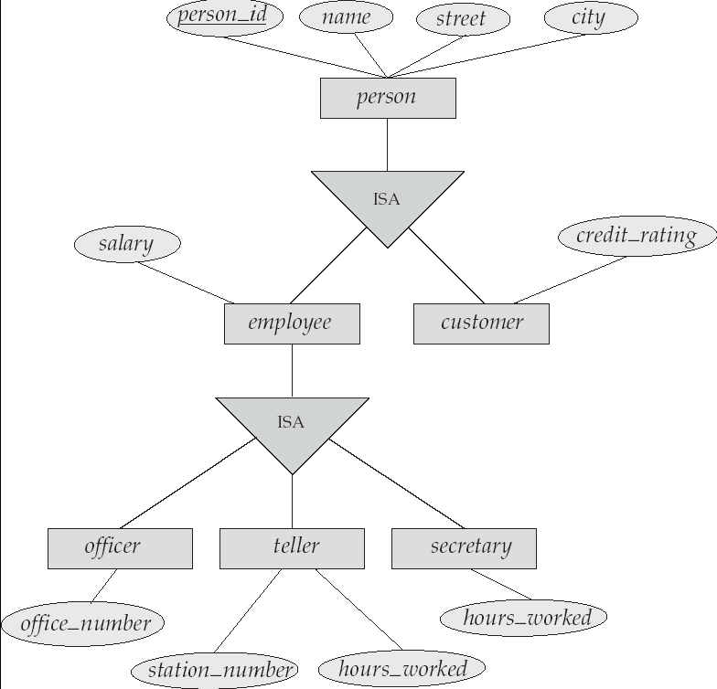
Specialization Example

Slide 29
Extended ER Features: Generalization
A bottom-up design process – combine a number of entity sets that share the same features into a higher-level entity set.
Specialization and generalization are simple inversions of each other; they are represented in an E-R diagram in the same way.
The terms specialization and generalization are used interchangeably.

Slide 30
Specialization and Generalization
Can have multiple specializations of an entity set based on different features.
E.g. permanent_employee vs. temporary_employee, in addition to officer vs. secretary vs. teller
Each particular employee would be
  a member of one of permanent_employee or temporary_employee,
  and also a member of one of officer, secretary, or teller
The ISA relationship also referred to as superclass - subclass relationship

Slide 31
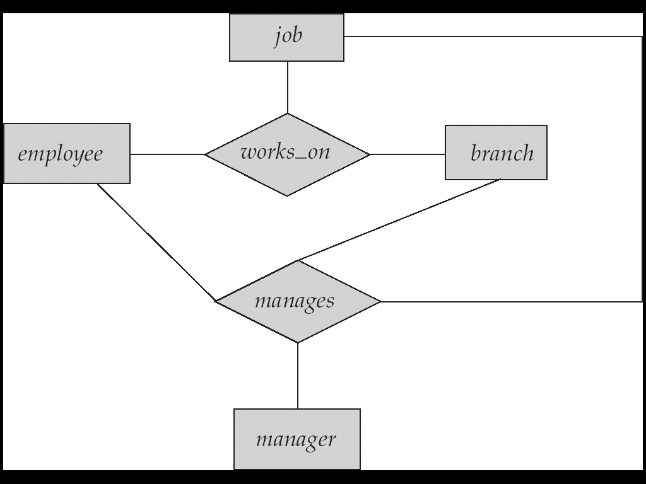
Aggregation
Consider the ternary relationship works_on, which we saw earlier
Suppose we want to record managers for tasks performed by an
employee at a branch

Slide 32
Aggregation (Cont.)
Relationship sets works_on and manages represent overlapping information
  Every manages relationship corresponds to a works_on relationship.
  However, some works_on relationships may not correspond to any manages relationships
  So we can’t discard the works_on relationship
Eliminate this redundancy via aggregation
  Treat relationship as an abstract entity
  Allows relationships between relationships
  Abstraction of relationship into new entity
Without introducing redundancy, the following diagram represents:
  An employee works on a particular job at a particular branch
  An employee, branch, job combination may have an associated manager

Slide 33
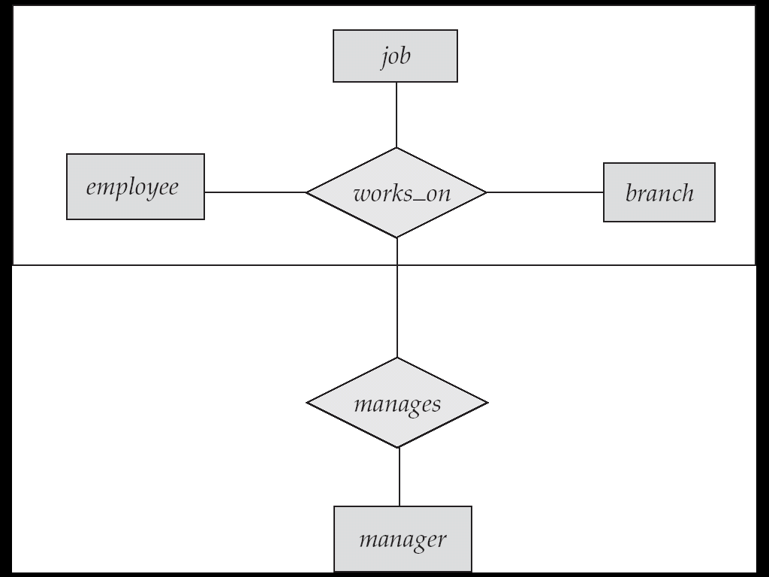
E-R Diagram With Aggregation

Slide 34
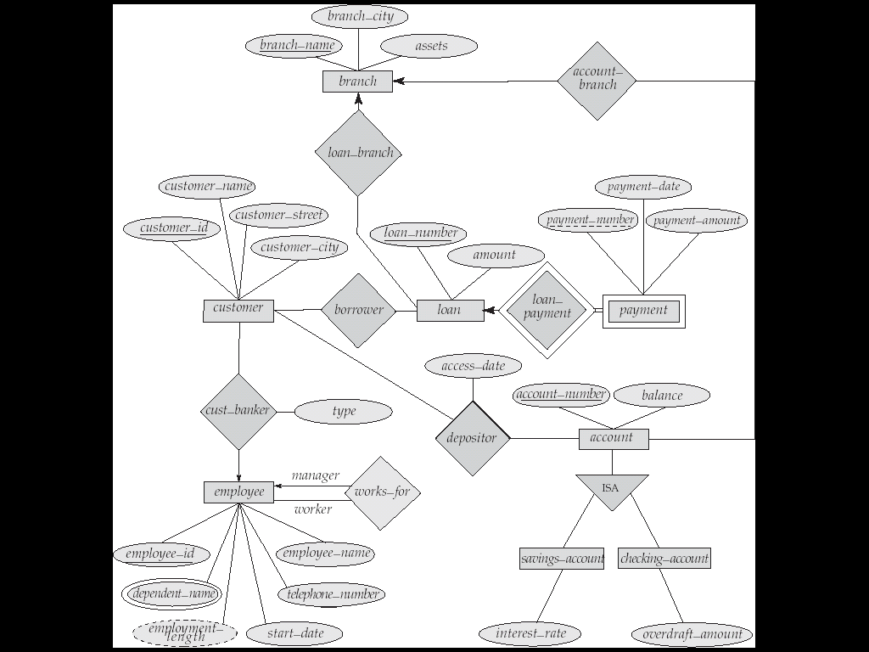
E-R Diagram for a Banking Enterprise

Slide 35
Reduction to Relation Schemas
Primary keys allow entity sets and relationship sets to be expressed uniformly as relation schemas that represent the contents of the database.
A database which conforms to an E-R diagram can be represented by a collection of schemas.
For each entity set and relationship set there is a unique schema that is assigned the name of the corresponding entity set or relationship set.
Each schema has a number of columns (generally corresponding to attributes), which have unique names.

Slide 36
Representing Entity Sets as Schemas
A strong entity set reduces to a schema with the same attributes.
A weak entity set becomes a table that includes a column for the primary key of the identifying strong entity set
payment =
( loan_number, payment_number, payment_date, payment_amount )

Slide 37
Representing Relationship Sets as Schemas
A many-to-many relationship set is represented as a schema with attributes for the primary keys of the two participating entity sets, and any descriptive attributes of the relationship set.
Example: schema for relationship set borrower
borrower = (customer_id, loan_number )

Slide 38
Some of the Currently Available Automated Database
Design Tools
COMPANY | TOOL | FUNCTIONALITY
Embarcadero Technologies | ER Studio | Database Modeling in ER and IDEF1X
 | DB Artisan | Database administration and space and security management
Oracle | Developer 2000 and Designer 2000 | Database modeling, application development
Popkin Software | System Architect 2001 | Data modeling, object modeling, process modeling, structured analysis/design
Platinum Technology | Platinum Enterprice Modeling Suite: Erwin, BPWin, Paradigm Plus | Data, process, and business component modeling
Persistence Inc. | Pwertier | Mapping from O-O to relational model
Rational | Rational Rose | Modeling in UML and application generation in C++ and JAVA
Rogue Ware | RW Metro | Mapping from O-O to relational model
Resolution Ltd. | Xcase | Conceptual modeling up to code maintenance
Sybase | Enterprise Application Suite | Data modeling, business logic modeling
Visio | Visio Enterprise | Data modeling, design and reengineering Visual Basic and Visual C++

